Slide 1
Developments of the Applications and Nuances of Hubble’s Constant
Ember Boicey, Everett Helm

Slide 2
Motivations
Measuring the accelerating of our universe and everything in it
The approximate age of the universe

Slide 3


Foundations
Hubble’s Constant: (km/s)/Mpc
Distance between celestial bodies
Velocity at which galaxies are moving
Using data from Tonry et al.2003 coding file

Slide 4
Process
Selecting a section of code to display on a distance by velocity graph
1
Calculating the line of best fit
2
Calculating the slope of said line
3
Using slope to estimate the Hubble Constant
4

Slide 5
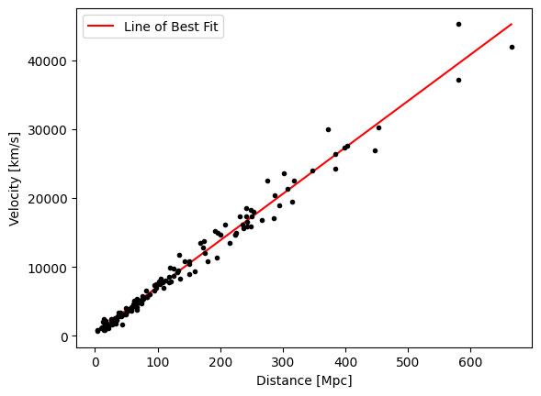

Results
Universe is expanding at an increasing rate
Hubble Constant should have a uniform value based on distance

Slide 6
Conclusions
Though this is a good approximation, the universe is vast and unknown, so we may never be able to solve the Hubble Constant accurately
With more precise measurements, we can reduce error and make a more accurate calculation

